Slide 1
Bootstrap Dropdown
廖向德

Slide 2
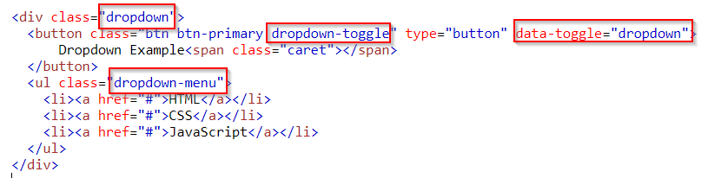
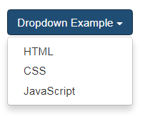
Basic Dropdown
The .dropdown class indicates a dropdown menu
To open the dropdown menu, use a button or a link with a class of .dropdown-toggle and the data-toggle="dropdown" attribute
Add the .dropdown-menu class to a <ul> element to actually build the dropdown menu Example
Notes:
<!DOCTYPE html>
<html>
<head>
<meta name="viewport" content="width=device-width, initial-scale=1">
<link rel="stylesheet" href="https://maxcdn.bootstrapcdn.com/bootstrap/3.3.7/css/bootstrap.min.css">
<script src="https://ajax.googleapis.com/ajax/libs/jquery/3.2.1/jquery.min.js"></script>
<script src="https://maxcdn.bootstrapcdn.com/bootstrap/3.3.7/js/bootstrap.min.js"></script>
</head>
<body>
<div class="container">
<h2>Dropdowns</h2>
<p>The .dropdown class is used to indicate a dropdown menu.</p>
<p>Use the .dropdown-menu class to actually build the dropdown menu.</p>
<p>To open the dropdown menu, use a button or a link with a class of .dropdown-toggle and data-toggle="dropdown".</p>
<div class="dropdown">
<button class="btn btn-primary dropdown-toggle" type="button" data-toggle="dropdown">Dropdown Example
<span class="caret"></span></button>
<ul class="dropdown-menu">
<li><a href="#">HTML</a></li>
<li><a href="#">CSS</a></li>
<li><a href="#">JavaScript</a></li>
</ul>
</div>
</div>
</body>
</html>

Slide 3
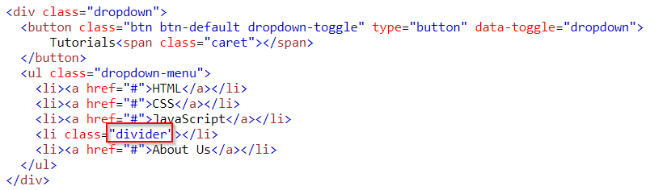
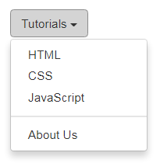
Dropdown Divider
The .divider class is used to separate links inside the dropdown menu with a thin horizontal border
Example
Notes:
<!DOCTYPE html>
<html>
<head>
<meta name="viewport" content="width=device-width, initial-scale=1">
<link rel="stylesheet" href="https://maxcdn.bootstrapcdn.com/bootstrap/3.3.7/css/bootstrap.min.css">
<script src="https://ajax.googleapis.com/ajax/libs/jquery/3.2.1/jquery.min.js"></script>
<script src="https://maxcdn.bootstrapcdn.com/bootstrap/3.3.7/js/bootstrap.min.js"></script>
</head>
<body>
<div class="container">
<h2>Dropdowns</h2>
<p>The .divider class is used to separate links inside the dropdown menu with a thin horizontal line:</p>
<div class="dropdown">
<button class="btn btn-default dropdown-toggle" type="button" data-toggle="dropdown">
Tutorials<span class="caret"></span>
</button>
<ul class="dropdown-menu">
<li><a href="#">HTML</a></li>
<li><a href="#">CSS</a></li>
<li><a href="#">JavaScript</a></li>
<li class="divider"></li>
<li><a href="#">About Us</a></li>
</ul>
</div>
</div>
</body>
</html>

Slide 4
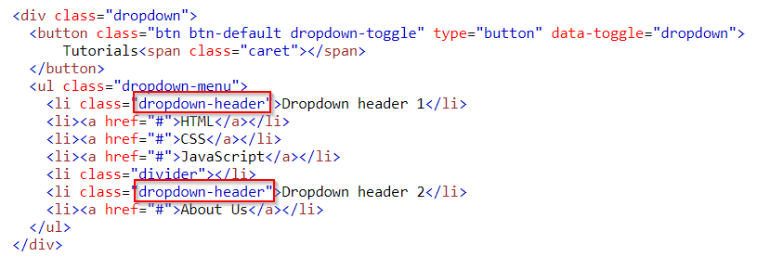
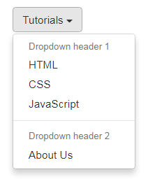
Dropdown Header
The .dropdown-header class is used to add headers inside the dropdown menu Example
Notes:
<!DOCTYPE html>
<html>
<head>
<meta name="viewport" content="width=device-width, initial-scale=1">
<link rel="stylesheet" href="https://maxcdn.bootstrapcdn.com/bootstrap/3.3.7/css/bootstrap.min.css">
<script src="https://ajax.googleapis.com/ajax/libs/jquery/3.2.1/jquery.min.js"></script>
<script src="https://maxcdn.bootstrapcdn.com/bootstrap/3.3.7/js/bootstrap.min.js"></script>
</head>
<body>
<div class="container">
<h2>Dropdowns</h2>
<p>The .dropdown-header class is used to add headers inside the dropdown menu:</p>
<div class="dropdown">
<button class="btn btn-default dropdown-toggle" type="button" data-toggle="dropdown">
Tutorials<span class="caret"></span>
</button>
<ul class="dropdown-menu">
<li class="dropdown-header">Dropdown header 1</li>
<li><a href="#">HTML</a></li>
<li><a href="#">CSS</a></li>
<li><a href="#">JavaScript</a></li>
<li class="divider"></li>
<li class="dropdown-header">Dropdown header 2</li>
<li><a href="#">About Us</a></li>
</ul>
</div>
</div>
</body>
</html>

Slide 5
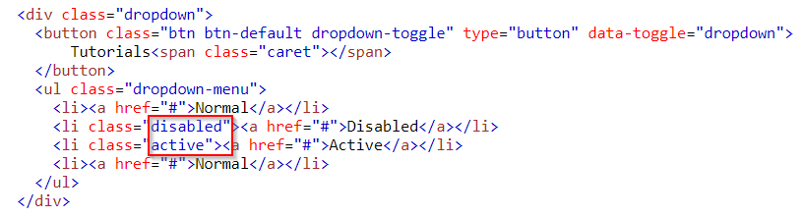
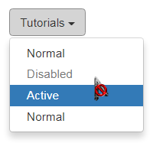
Disable and Active items
Highlight a dropdown item with the .active class
To disable an item, use the .disabled class Example
Notes:
<!DOCTYPE html>
<html lang="en">
<head>
<title>Bootstrap Example</title>
<meta charset="utf-8">
<meta name="viewport" content="width=device-width, initial-scale=1">
<link rel="stylesheet" href="https://maxcdn.bootstrapcdn.com/bootstrap/3.3.7/css/bootstrap.min.css">
<script src="https://ajax.googleapis.com/ajax/libs/jquery/3.2.1/jquery.min.js"></script>
<script src="https://maxcdn.bootstrapcdn.com/bootstrap/3.3.7/js/bootstrap.min.js"></script>
</head>
<body>
<div class="container">
<h2>Dropdowns</h2>
<p>The .active class adds a blue background color to the active link.</p>
<p>The .disabled class disables a dropdown item (grey text color).</p>
<div class="dropdown">
<button class="btn btn-default dropdown-toggle" type="button" data-toggle="dropdown">Tutorials
<span class="caret"></span></button>
<ul class="dropdown-menu">
<li><a href="#">Normal</a></li>
<li class="disabled"><a href="#">Disabled</a></li>
<li class="active"><a href="#">Active</a></li>
<li><a href="#">Normal</a></li>
</ul>
</div>
</div>
</body>
</html>

Slide 6
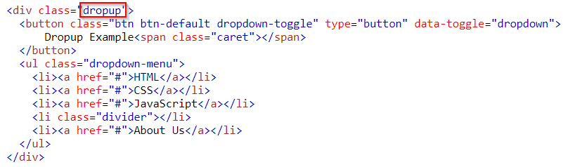
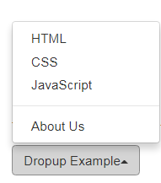
Dropup
If you want the dropdown menu to expand upwards instead of downwards, change the <div> element with class="dropdown" to "dropup"
Notes:
<!DOCTYPE html>
<html>
<head>
<meta name="viewport" content="width=device-width, initial-scale=1">
<link rel="stylesheet" href="https://maxcdn.bootstrapcdn.com/bootstrap/3.3.7/css/bootstrap.min.css">
<script src="https://ajax.googleapis.com/ajax/libs/jquery/3.2.1/jquery.min.js"></script>
<script src="https://maxcdn.bootstrapcdn.com/bootstrap/3.3.7/js/bootstrap.min.js"></script>
</head>
<body>
<br><br><br><br><br><br><br>
<div class="container">
<h2>Dropdowns</h2>
<p>The .dropup class makes the dropdown menu expand upwards instead of downwards:</p>
<div class="dropup">
<button class="btn btn-default dropdown-toggle" type="button" data-toggle="dropdown">
Dropup Example<span class="caret"></span>
</button>
<ul class="dropdown-menu">
<li><a href="#">HTML</a></li>
<li><a href="#">CSS</a></li>
<li><a href="#">JavaScript</a></li>
<li class="divider"></li>
<li><a href="#">About Us</a></li>
</ul>
</div>
</div>
</body>
</html>

